Slide 1
Models of disassembly
Lishibanya Mohapatra
Lena Burdick

Slide 2
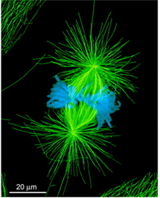
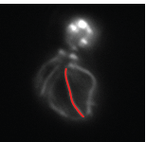
Examples of length regulated cytoskeletal structures
Mitotic spindle
Cilia
Actin cables
Size of the structure is maintained despite
a rapid turnover of the components!

Slide 3
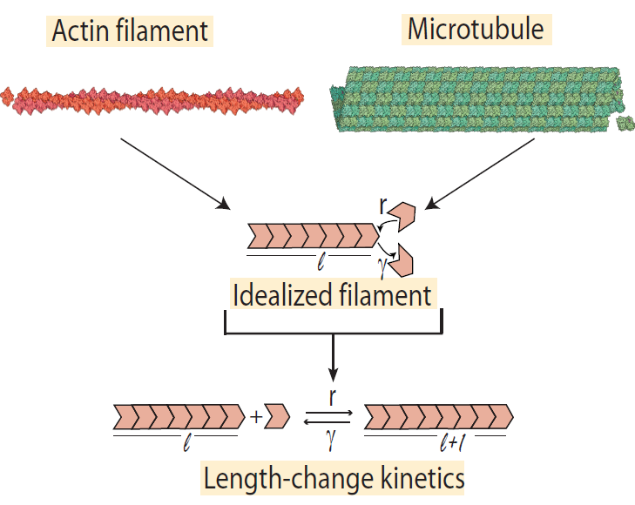
Consider one-dimensional structures and use filament length as our variable
Rate of assembly = r
Rate of disassembly = γ

Slide 4
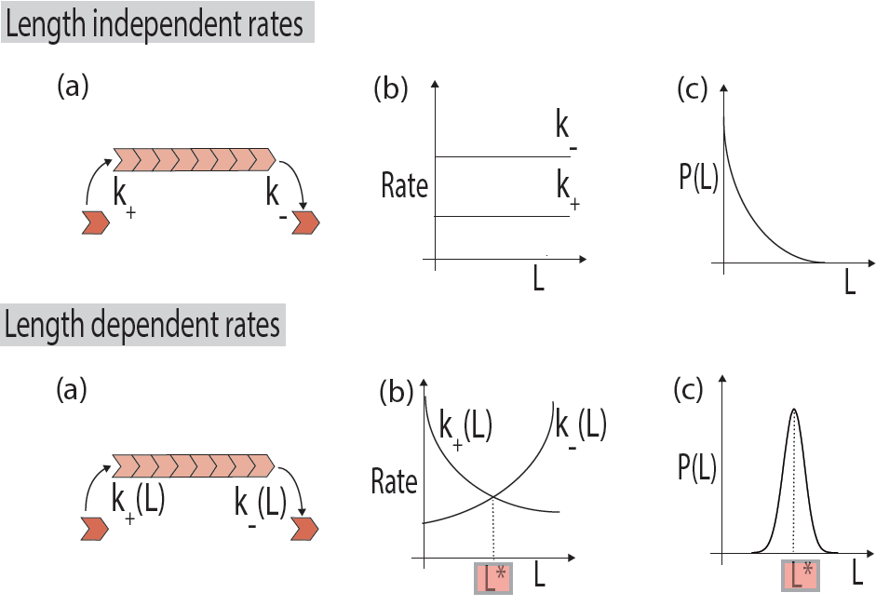
Use length of the filament as our variable
r
𝛾
r
𝛾
Two possibilities
𝛾
r
Rate of assembly > Rate of disassembly
Rate of assembly < Rate of disassembly
Filament keeps growing!
(Indefinitely)
Filament will shrink more
than grow!

Slide 5
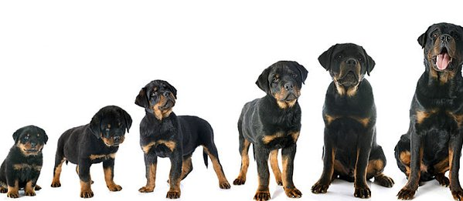
For size-control..
“Steady-state”
Size
Time
..we need non-zero size at steady state

Slide 6
Balance the rates of assembly and disassembly!
r(L)
𝛾(L)
Length-dependent rates to the rescue..
Assembly and disassembly rate curves need to intersect
i.e. be functions of length

Slide 7
Stability issues
Disassembly
Assembly
Assembly
Disassembly
Rate
γ(L)
r(L)
Rate
r(L)
γ(L)
L*
Length
L*
Length

Slide 8
Stability issues
Disassembly
Assembly
Assembly
Disassembly
Rate
γ(L)
r(L)
Rate
r(L)
γ(L)
L*
Length
L*
Length
Unstable!
Stable!

Slide 9
Stability issues
Disassembly
Assembly
Assembly
Disassembly
Rate
γ(L)
r(L)
Rate
r(L)
γ(L)
L*
Length
L*
Length
Unstable!
Stable!
Rate of assembly → decrease with length
Rate of disassembly → increase with length

Slide 10
Length-dependent rates are required for size control
r(L)
𝛾(L)
r(L)
𝛾(L)
Balance the rates of assembly and disassembly!
Peaked distribution!

Slide 11
Models of disassembly

Slide 12
Unassisted disassembly
Constant rate, depends on polymer properties
Assisted disassembly
By End-binding proteins
Diffusion mediated
By Motor proteins
+
+
+
+

Slide 13
Unassisted disassembly
Constant rate, depends on polymer properties
Assisted disassembly
By End-binding proteins
Diffusion mediated
By Motor proteins
+
+
+
+

Slide 14
Results
Length
Simulate just the disassembly process
Obtain Length vs Time plots
Slope of the graph = disassembly rate
time
??
??
Disassembly rate
Disassembly rate
[ ]
Length

Slide 15
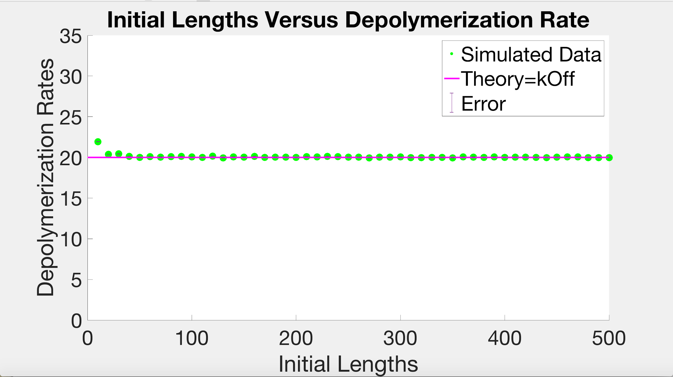
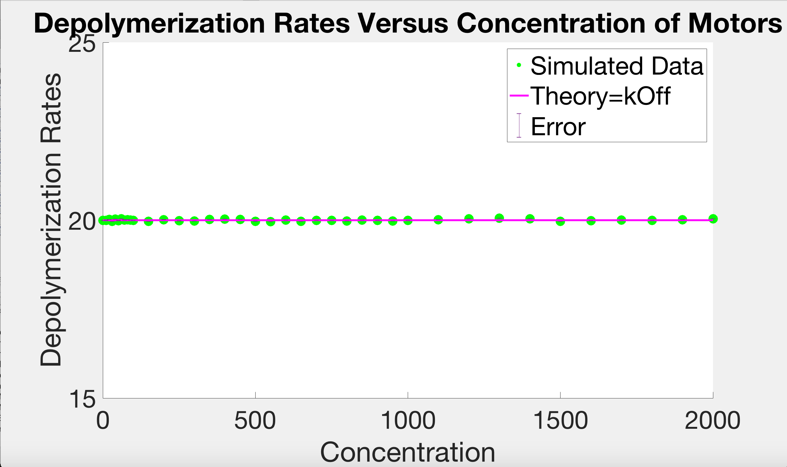
Unassisted disassembly
+
Plots by Lena

Slide 16
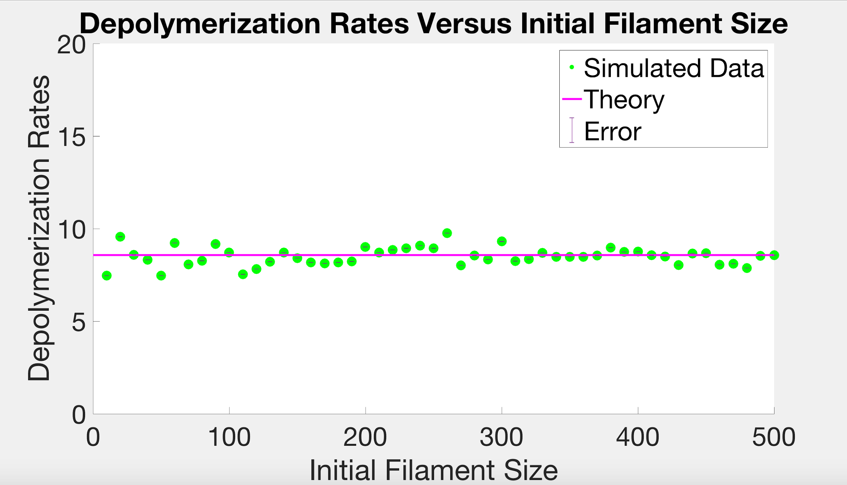
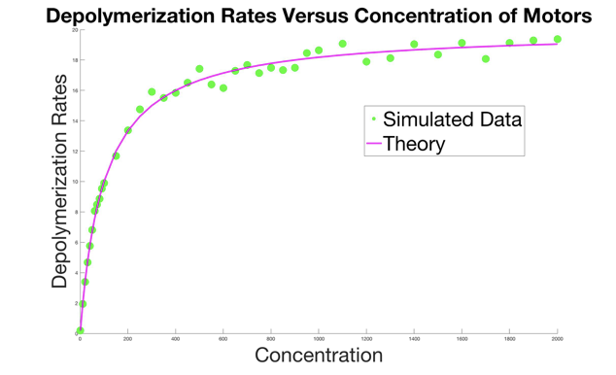


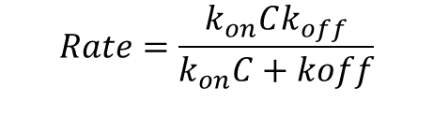
End binding protein assisted disassembly
$$k_{on}$$
$$k_{off}$$
+
Plots by Lena
$$Rate=\frac{k_{on}Ck_{off}}{k_{on}C+koff}$$

Slide 17
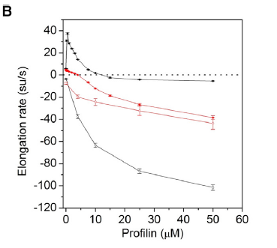
Possible application: Profilin mediated disassembly at barbed end
Data from Pernier, Shashank et al Dev Cell 2016
Profilin
Actin
+
-
k1
k3
+
k2
k_dis

Slide 18
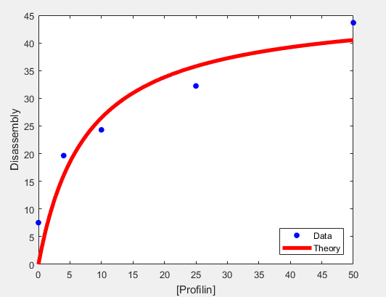
Experimental Data (from Shashank)
f1(x) = k1*x*k3/(k1*x+k3)
Coefficients (with 95% confidence bounds):
k3 = 46.72 (20.14, 73.3) 𝜇M⁻¹ s⁻¹
k1 = 6.108 (-2.789, 15) s⁻¹
+
-
k1
k3
+
k2
k_dis

Slide 19


Diffusion mediated disassembly
$$k_{on}$$
+
$$k_{off}$$

Slide 20
Diffusion mediated disassembly
$$k_{on}$$
+
$$k_{off}$$
Observations:
Diffusion is FREE - Doesn’t cost energy.
Can go to both the ends (as opposed to one end via walking motors)
Time to diffuse to the ends will depend on the length of the filament
Depolymerization rate should depend on the length and the concentration of proteins
Is there a limit where getting to end via diffusion would be faster that protein being able to bind to the ends directly?

Slide 21
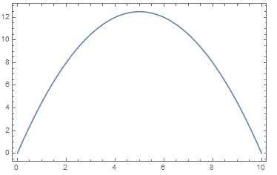





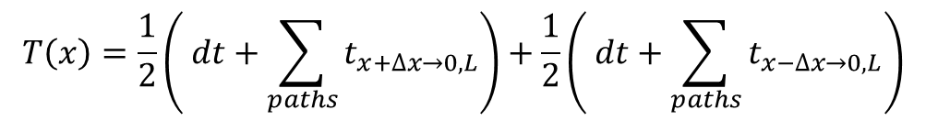
Time taken to reach ends : First passage times
$$T\left(x\right):time take to reach 0 or L, while starting from x$$
$$=\sum_{paths}{t_{x→0, L}}$$
$$T\left(x\right)=\frac{1}{2}\left( dt+\sum_{paths}{t_{x+∆x→0,L}}\right)+\frac{1}{2}\left( dt+\sum_{paths}{t_{x−∆x→0,L}}\right)$$
Time
$$T\left(x\right)= ∆t+\frac{1}{2}T\left(x+∆x\right)+\frac{1}{2} T(x−∆x)$$
Solution:
$$\frac{∂^{2} T}{∂x^{2}}=−\frac{1}{D}$$
$$T\left(x\right)=\frac{x}{2D}(L−x)$$
$$T\left(L\right)=T\left(0\right)=0$$
Starting position on the filament

Slide 22

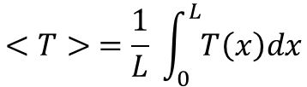
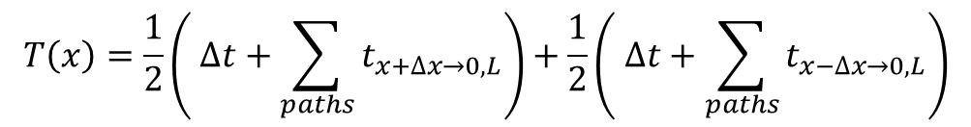
Time taken to reach ends : First passage times
$$T\left(x\right):time take to reach 0 or L, while starting from x$$
$$=\sum_{paths}{t_{x→0, L}}$$
$$T\left(x\right)=\frac{1}{2}\left( ∆t+\sum_{paths}{t_{x+∆x→0,L}}\right)+\frac{1}{2}\left( ∆t+\sum_{paths}{t_{x−∆x→0,L}}\right)$$
Time
$$T\left(x\right)= ∆t+\frac{1}{2}T\left(x+∆x\right)+\frac{1}{2} T(x−∆x)$$
Solution:
$$\frac{∂^{2} T}{∂x^{2}}=−\frac{1}{D}$$
$$T\left(x\right)=\frac{x}{2D}(L−x)$$
$$T\left(L\right)=T\left(0\right)=0$$
Starting position on the filament
$$<T> =\frac{1}{L} \int_{0}^{L}{T\left(x\right)dx}$$
$<T> =\frac{1}{L} \left(\frac{1}{2D}\right) \left(\frac{L^{3}}{2} −\frac{L^{3}}{3}\right)=\frac{L^{2}}{12D}$
Diffusion!

Slide 23
Time taken to reach ends : First passage times
$$T\left(x\right):time take to reach 0 or L, while starting from x$$
$$=\sum_{paths}{t_{x→0, L}}$$
$$T\left(x\right)=\frac{1}{2}\left( dt+\sum_{paths}{t_{x+∆x→0,L}}\right)+\frac{1}{2}\left( dt+\sum_{paths}{t_{x−∆x→0,L}}\right)$$
Time
$$T\left(x\right)= ∆t+\frac{1}{2}T\left(x+∆x\right)+\frac{1}{2} T(x−∆x)$$
Solution:
$$\frac{∂^{2} T}{∂x^{2}}=−\frac{1}{D}$$
$$T\left(x\right)=\frac{x}{2D}(L−x)$$
$$T\left(L\right)=T\left(0\right)=0$$
Starting position on the filament
$$<T> =\frac{1}{L} \int_{0}^{L}{T\left(x\right)dx}$$
$<T> =\frac{1}{L} \left(\frac{1}{2D}\right) \left(\frac{L^{3}}{2} −\frac{L^{3}}{3}\right)=\frac{L^{2}}{12D}$
Diffusion!

Slide 24


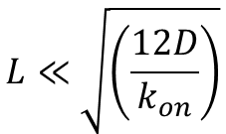
Time to filament end via 3D diffusion vs. 1D diffusion
T1 = 3D diffusion to the end
T2 = Diffusion capture on the filament, any point on the filament in likely
T3 = time to the end via 1D diffusion
$$k_{on}$$
T2
T3
$$\frac{1}{k_{on}}≫\frac{L^{2}}{12D}+\frac{1}{(L/a) k_{on}}$$
T1
$$L≪\sqrt{\left(\frac{12D}{k_{on}}\right)}$$
For
it is faster to diffuse 1D on the filament rather than get to the end via 3D diffusion
Low concentration of free proteins ?

Slide 25






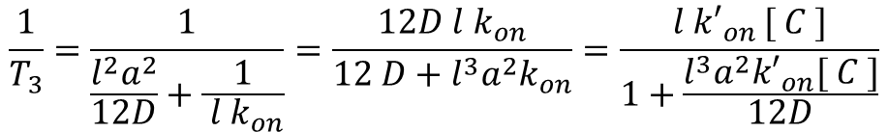
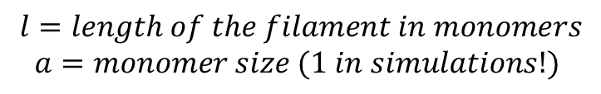

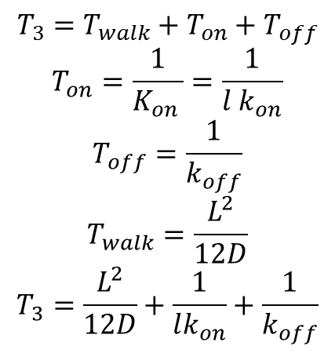
Implication on length control
$$T_{3}=T_{walk}+T_{on}+T_{off}$$
$$T_{on}=\frac{1}{K_{on }}=\frac{1}{l k_{on}}$$
$$T_{off}=\frac{1}{k_{off}}$$
$$T_{walk}=\frac{L^{2}}{12D}$$
$$T_{3}=\frac{L^{2}}{12D}+\frac{1}{lk_{on}}+\frac{1}{k_{off}}$$
$$l=length of the filament in monomers$$
$$a=monomer size (1 in simulations!)$$
Using $L = l × a$
All units of $s^{−1}$
Disassembly rate = $\frac{1}{T_{3}}=$
I’ve ignored $k_{off}$ here..
$$\frac{1}{T_{3}}=\frac{1}{\frac{l^{2}a^{2}}{12D}+\frac{1}{ {l k}_{on}}}=\frac{12D l k_{on}}{12 D+l^{3}a^{2}k_{on}}=\frac{l {k′}_{on }[ C ]}{1+\frac{l^{3}a^{2}{k′}_{on}[ C ]}{12D}}$$
Limits for which disassembly rate is an increasing function of length.. (For optimal size-control!)
$${l^{3}a}^{2}\frac{k_{on}^{′}\left[C\right]}{12D }≪1$$
$${l^{3}a}^{2}\frac{4 π a D_{3}\left[C\right]}{12D_{1} }≪1$$
$$\frac{L^{3} D_{3} \left[C\right]}{D_{1} }≪1$$

Slide 26
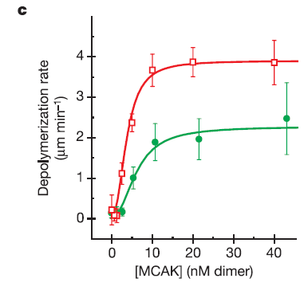
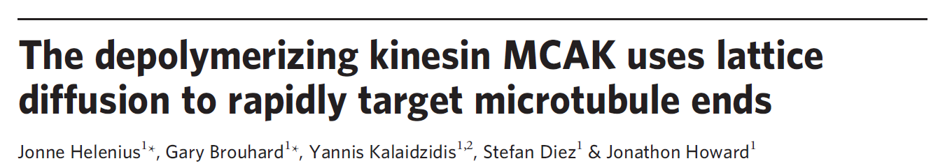
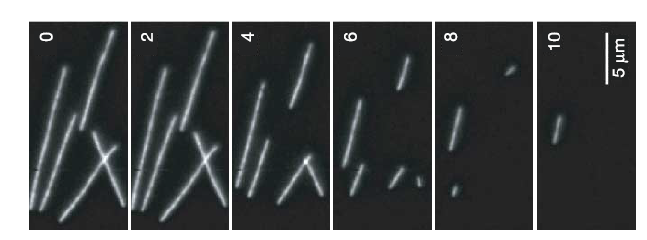
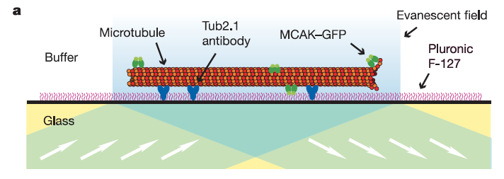
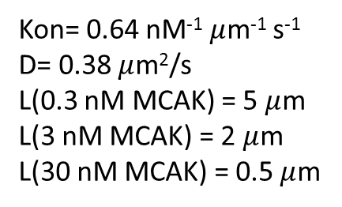
Example:Diffusion-mediated disassembly
Experimental parameters:
Kon= 0.64 nM⁻¹ $μ$m⁻¹ s⁻¹
D= 0.38 $μ$m²/s
L(0.3 nM MCAK) = 5 $μ$m
L(3 nM MCAK) = 2 $μ$m
L(30 nM MCAK) = 0.5 $μ$m

Slide 27
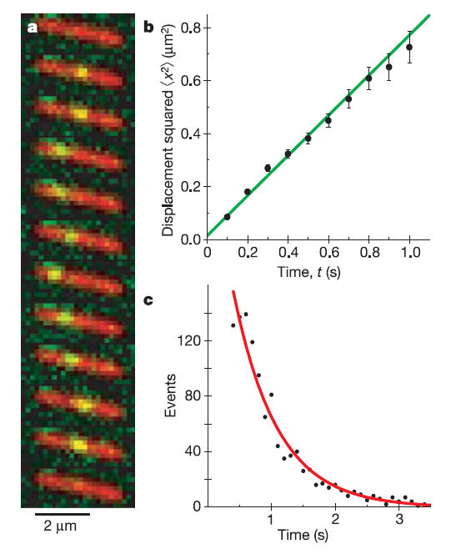
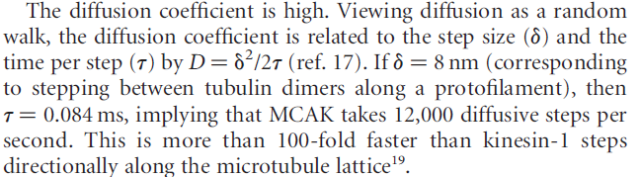
Diffusion

Slide 29

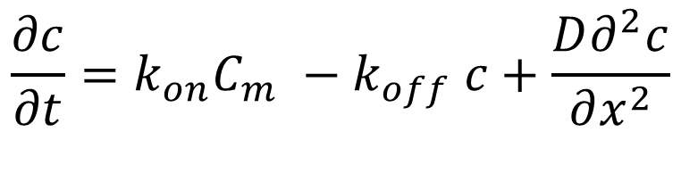
Diffusion mediated disassembly
$$k_{on}$$
+
$$k_{off}$$
dissociation
$$\frac{∂c}{∂t}=k_{on}C_{m} −k_{off} c+\frac{D∂^{2}c}{∂x^{2}}$$
association
diffusion on the filament

Slide 30

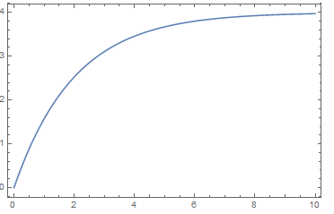

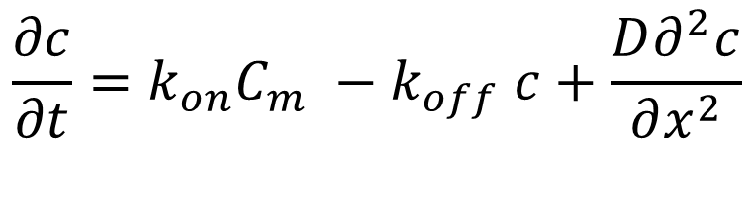

Diffusion mediated disassembly
$$k_{on}$$
+
$$k_{off}$$
dissociation
$$\frac{∂c}{∂t}=k_{on}C_{m} −k_{off} c+\frac{D∂^{2}c}{∂x^{2}}$$
association
diffusion on the filament
$$c\left(x\right)=c_{0} \left(1−e^{−x/x_{0}}\right)$$
$$x_{0}=\frac{D}{k_{off}}$$
Flux to the end:
$−D ∂$c/$∂x=−D\frac{c_{0}}{x_{0}}$
Concentration
Distance on the filament

Slide 31
Diffusion mediated disassembly
+
Depolymerization w initial length filament
Depolymerization w concentration of protein

Slide 32
Motor associated disassembly

Slide 33
Depolymerizationrate for two step
<Time> = 1/kon +1/koff
kon = kon’C
1/<Time>= d = koff*kon’C/(kon’C+ koff)
Hill equation: 1/(1+ (Ka/[L])^{n})

Slide 34
+
-
k1
k3
+
k2
k_dis
+
-
k1
k3
+
k2
k_dis

Slide 35
+
-
k1
k3
Pathway 1
+
k2
k_dis
+
-
k1
k3
Pathway 2
+
Fragment off
k2
k_dis

Slide 36
Srv-2 mediated disassembly at pointed end
+
-
k1
k3
Pathway 1
+
k2
k_dis
+
-
k1
k3
Pathway 2
+
Fragment off
k2
f
k_dis

Slide 37
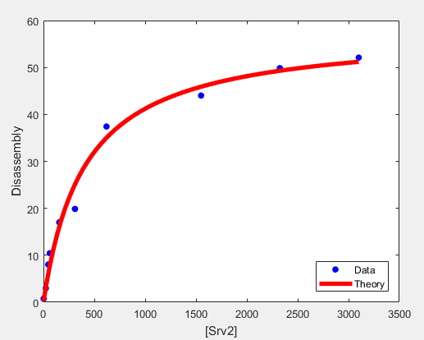
Srv2 data
General model:
f1(x) = kon*x*koff/(kon*x+koff)
Coefficients (with 95% confidence bounds):
koff = 57.89 (52.74, 63.05) sec ⁻¹
kon = 0.143 (0.1099, 0.1761) 𝜇M ⁻¹ sec ⁻¹

